Slide 1

Bank history and moving money
José Armando Melchor Soto - 745697

Slide 2
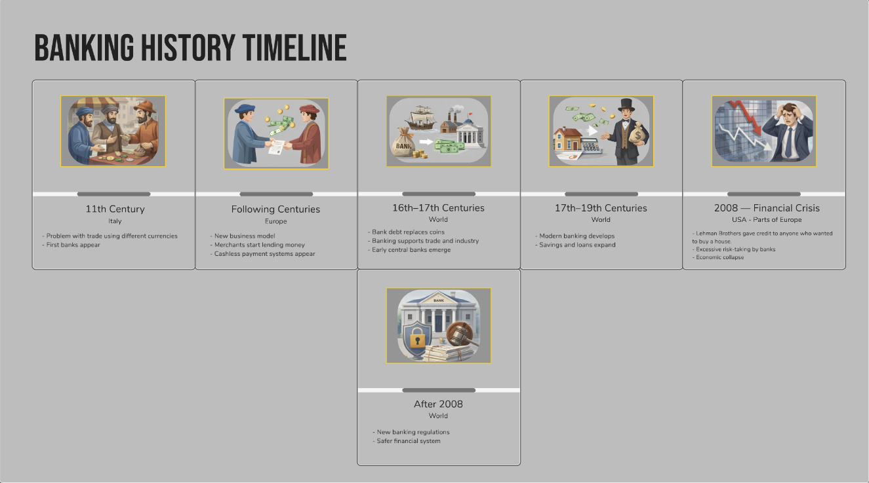
History of Banks

Slide 3
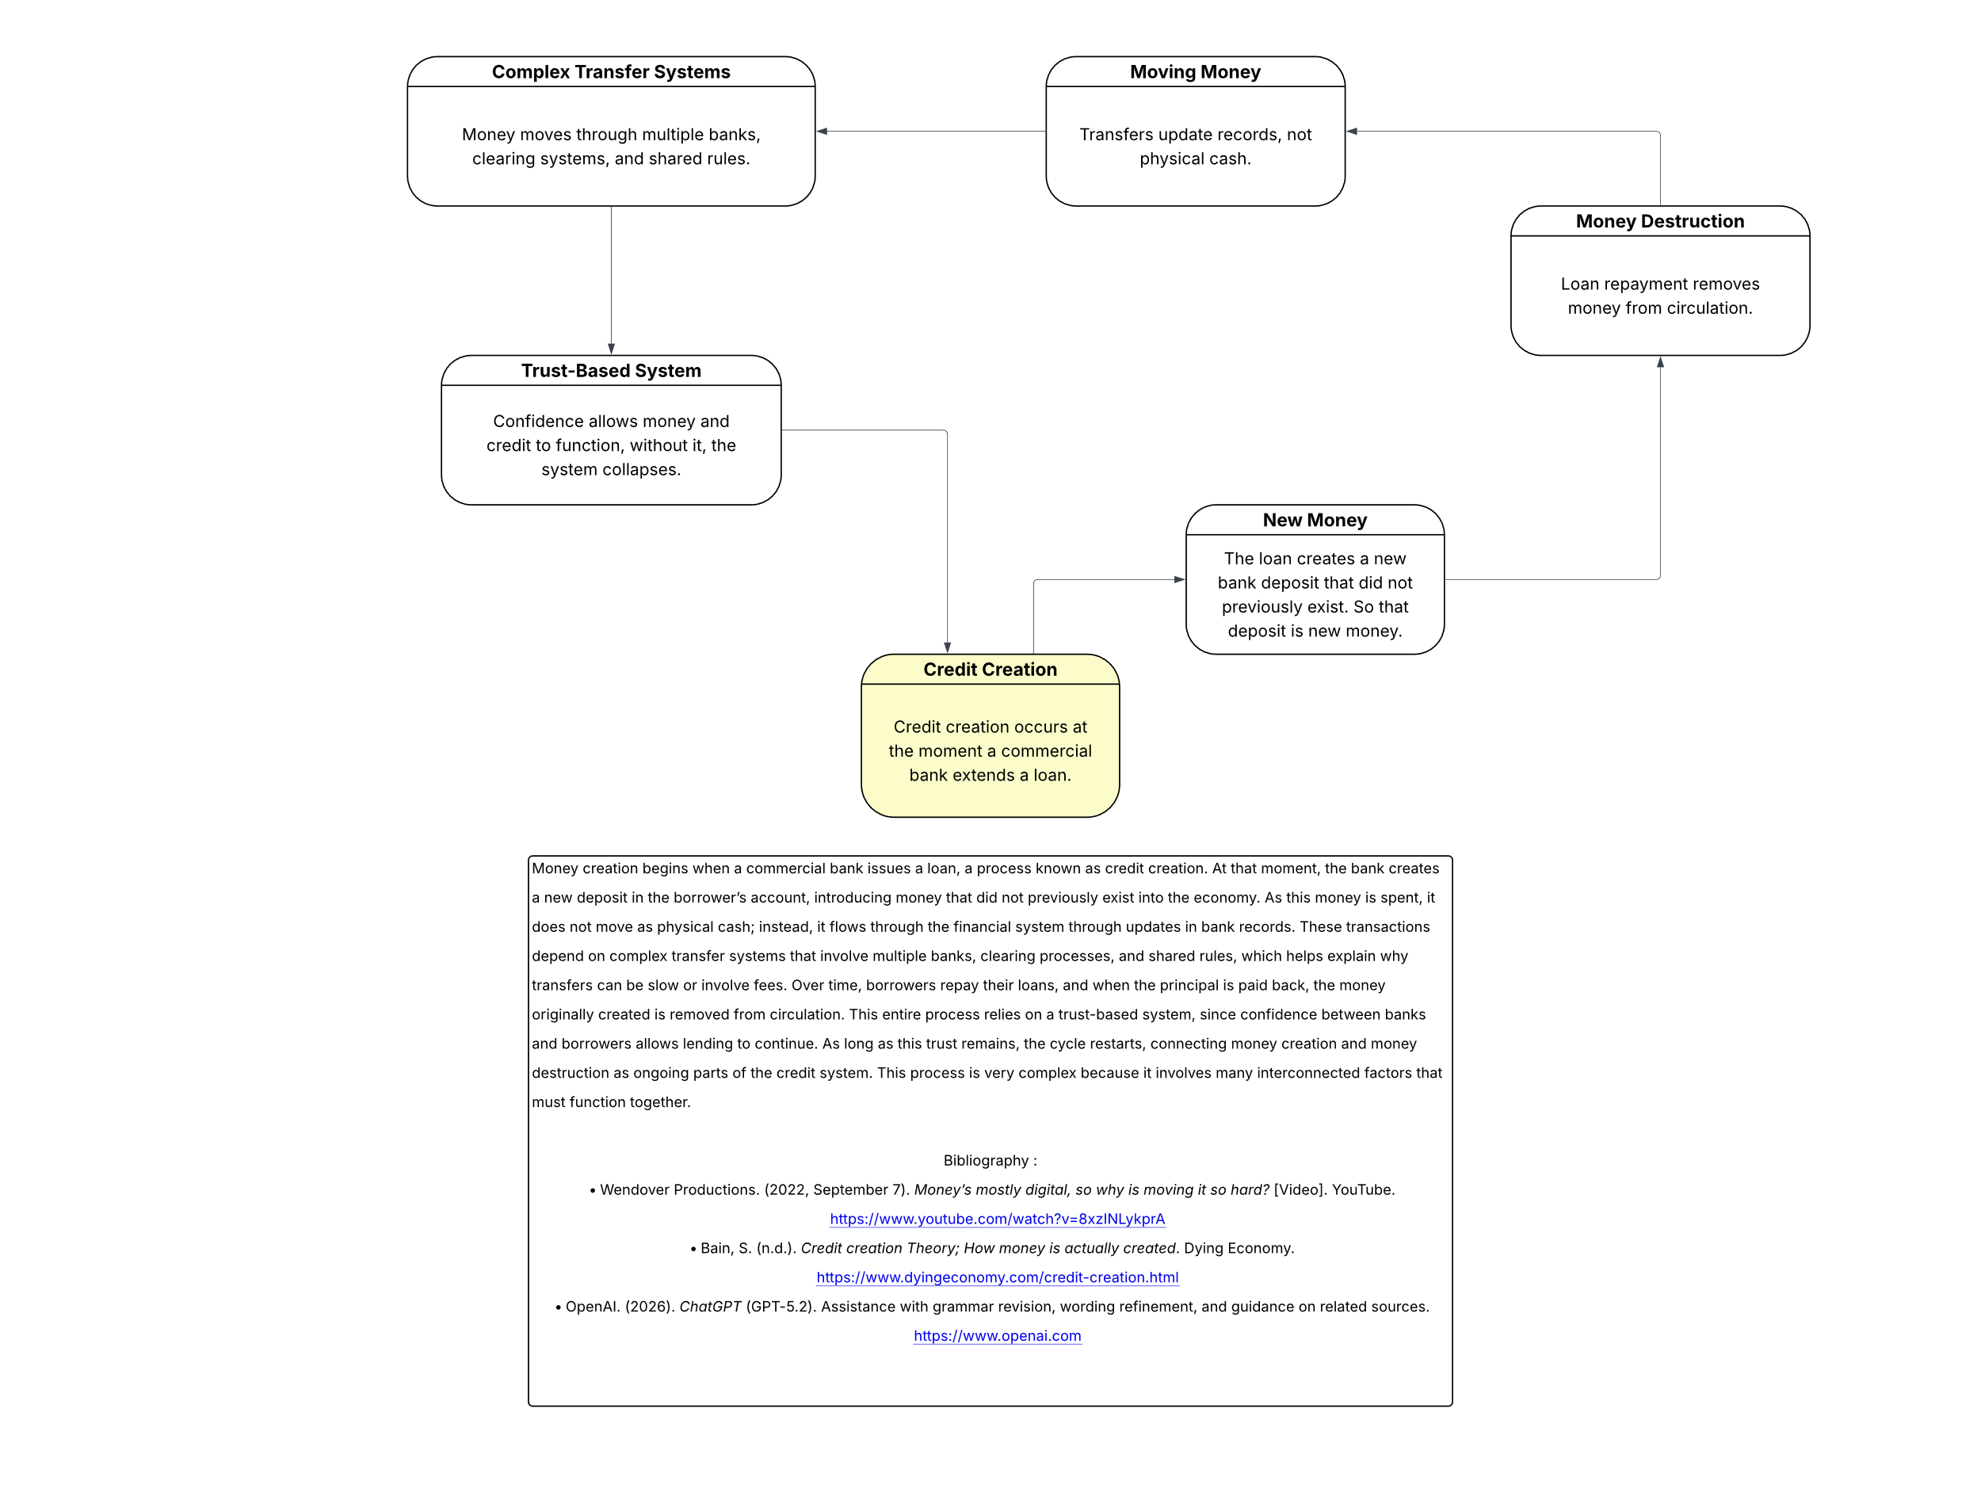
Understanding Money Creation and the Complexity of Money Movement
Part 1: Flow Chart on Money Creation through Credit
Money creation begins when a commercial bank issues a loan, a process known as credit creation. At that moment, the bank creates a new deposit in the borrower’s account, introducing money that did not previously exist into the economy. As this money is spent, it does not move as physical cash; instead, it flows through the financial system through updates in bank records. These transactions depend on complex transfer systems that involve multiple banks, clearing processes, and shared rules, which helps explain why transfers can be slow or involve fees. Over time, borrowers repay their loans, and when the principal is paid back, the money originally created is removed from circulation. This entire process relies on a trust-based system, since confidence between banks and borrowers allows lending to continue. As long as this trust remains, the cycle restarts, connecting money creation and money destruction as ongoing parts of the credit system. This process is very complex because it involves many interconnected factors that must function together.

Slide 4

Bibliography
Kurzgesagt – In a Nutshell. (2015, March 12). Banking explained – money and credit [Video]. YouTube. https://www.youtube.com/watch?v=fTTGALaRZoc
Wikipedia contributors. (2026, January 8). History of banking. Wikipedia. https://en.wikipedia.org/wiki/History_of_banking
colaboradores de Wikipedia. (2026, January 28). Historia de la banca. Wikipedia, La Enciclopedia Libre. https://es.wikipedia.org/wiki/Historia_de_la_banca
OpenAI. (2026). Images generated by ChatGPT for a banking history timeline based on author-provided content [Artificial intelligence–generated images]. https://chat.openai.com/
-----------------------------------------------------------------------------
Wendover Productions. (2022, September 7). Money’s mostly digital, so why is moving it so hard? [Video]. YouTube. https://www.youtube.com/watch?v=8xzINLykprA
Bain, S. (n.d.). Credit creation Theory; How money is actually created. Dying Economy. https://www.dyingeconomy.com/credit-creation.html
OpenAI. (2026). ChatGPT (GPT-5.2). Assistance with grammar revision, wording refinement, and guidance on related sources. https://www.openai.com

